Slide 1
25 Website Traffic
Methods Exposed
Proven Methods to Get
Targeted Traffic To Your Website

Slide 2
Website Traffic & Your Business
Without website traffic your online business will not survive.
Traffic brings you the audience that takes action on your site.
Targeted website traffic is the best type of traffic you can get.
Don’t put all your eggs in one basket.
Rely on traffic from a variety of sources.
Be consistent with your traffic efforts.
Remember that content is key to any traffic strategy.

Slide 3
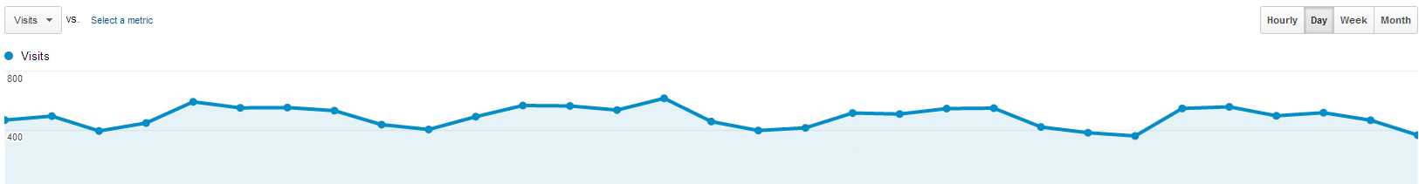
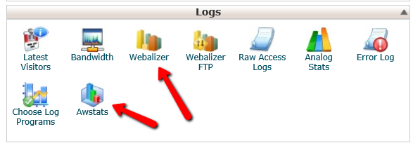
Tracking Your Website Visitors
Google Analytics – www.google.com/analytics
Webalizer or AWStats from your site’s Cpanel.

Slide 4
Proven Website Traffic Methods
SEO (Search Engine Optimization)
Facebook
Pinterest
Twitter
PPC Ads
Paid Banner Ads
Amazon
Blogging
RSS Submissions
Forum Marketing
Q&A Sites
Press Releases
Online Classifieds
Directory Submissions
Social Bookmarking
Article Submissions
Guest Blogging
Web 2.0 Sites (Squidoo, etc.)
Old School Marketing
Solo Ads
Joint Ventures
Blog Commenting
Viral Report
Video Marketing
Document Sharing Sites

Slide 5
Traffic Method #1: SEO
SEO or Search Engine Optimization is working to improve a websites position and visibility in the organic (un-paid) results.
The higher the rankings, the more targeted traffic you receive.
Target keywords that will send you the right kind of visitors.
SEO begins with proper keyword research.
  Google Adwords Keyword Tool
  https://adwords.google.com/o/KeywordTool
  SEO Book Keyword Tool
  http://tools.seobook.com/keyword-tools/seobook/
SEO includes making changes to your site to help search engines find and display your content to their users.
A growing factor in SEO is social signals.
You also want to get quality backlinks and content distribution.

Slide 6
Traffic Method #1: SEO
Start with On Page SEO. This involves:
  Changing the HTML coding (Title Tags and Meta Description)
  How content is worded and displayed.
  Structure of your content and inner linking.
On Page Change #1: Title Tags
  Your target keywords should appear in the title tag.
  Most important On Page SEO factor.
  Create unique title tags for each page of content.
  No more than 70 characters and keep site branding for last.

Slide 7
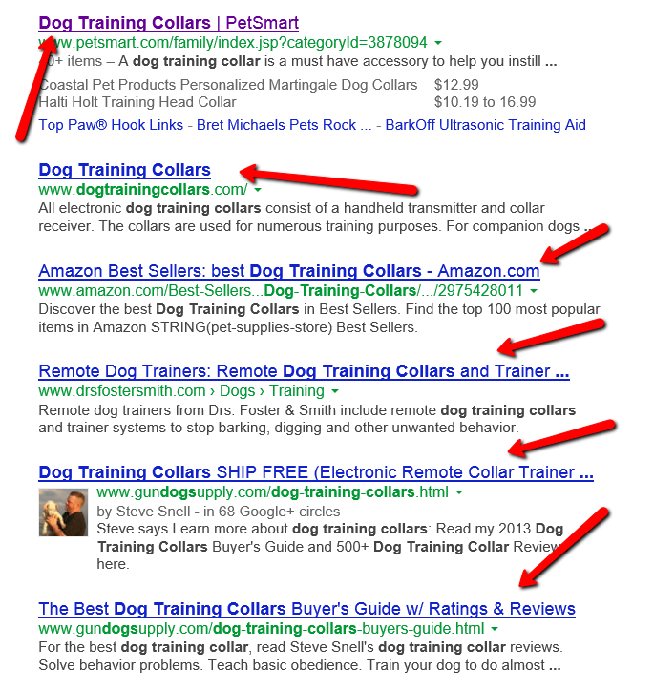
Traffic Method #1: SEO

Slide 8
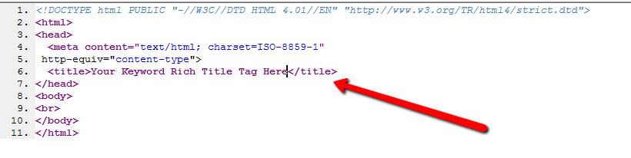
Traffic Method #1: SEO
Editing Your Title Tags
  Found near the top of the HTML coding.
  Appears like this in the HTML coding:
  <title>Your Keyword Rich Title Tag Here</title>
  Use an HTML editor like Kompozer in ‘Source’ mode to edit this.
  In Wordpress use a plugin like All-In-One SEO Pack.

Slide 9
Traffic Method #1: SEO
Editing Your Title Tags
  Found near the top of the HTML coding.
  Appears like this in the HTML coding:
  <title>Your Keyword Rich Title Tag Here</title>
  Use an HTML editor like Kompozer in ‘Source’ mode to edit this.
  In Wordpress use a plugin like All-In-One SEO Pack.

Slide 10
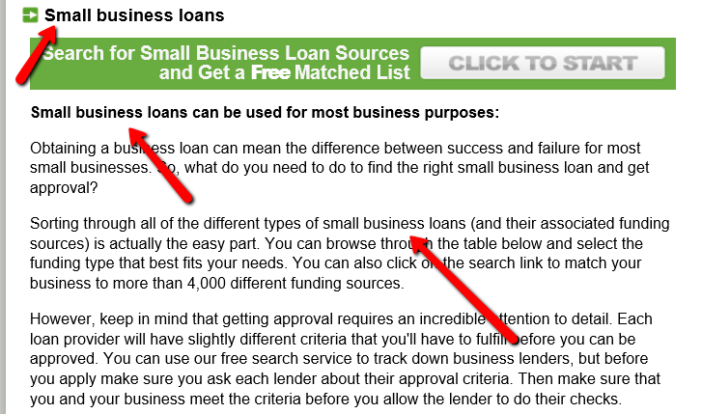
Traffic Method #1: SEO
On Page Change #2: Improving How Your Content Is Displayed
  Use proper header tags like <h1>, <h2>, and <h3>.

Slide 11
Traffic Method #1: SEO
Creating Proper Header Tags (H1, H2, or H3).
  Use an HTML editor like Kompozer and select your text style.
  It will say: “Heading 1, Heading 2, Heading 3”.
  Incorporate your keywords into the header tags.
  In Wordpress you can create header tags similar to Kompozer.
  Under the ‘Paragraph’ drop down choose your heading style.
Your Website’s Content
  Don’t overuse your keywords.
  Try to use your main keyword phrase in the opening and closing paragraph.
  Use your keywords where they make sense.
  Write for humans and you will see a better stick rate.
  Focus on quality content.

Slide 12
Traffic Method #1: SEO
On Page Change #3: Internal Linking – Get Your Content Found
  Setup a Sitemap which contains all the links to your internal pages on one page.
  If using Wordpress use the Google XML Sitemaps Plugin.
  Use text based links when linking internally to your pages.
  Don’t link through javascript links, images, flash, etc.
  Wordpress sites have an RSS feed which is another plus.
On Page Change #4: Improve Your Site’s Page Speed
  Check the page speed of your home page using Google’s PageSpeed Insights Tool.
  Run a search for

Slide 13
Traffic Method #1: SEO
Other Important SEO Considerations
  Incorporate social sharing buttons onto your site.
  Include Google+, Facebook, and Twitter buttons.
  Use something like the ‘AddThis’ sharing tool.
  Keep your content updated and fresh.
  When creating your content focus on quality over quantity.
  Create content that would encourage shares from others.
  Think of top 10 articles, how to articles, case studies, etc.
  Create content that fits your niche audience.
  Incorporate pictures, videos, and external links in with your content.
  Create a blog on your site if you don’t have one already.
  Google search: ‘site:yourdomain.com’ to see how it is being indexed.

Slide 14
Traffic Method #1: SEO
SEO and Backlinking
  Only get links from quality sources.
  Quality links are way more valuable, than a large quantity of links.
  Don’t just do one backlinking strategy.
  Have variety with your backlinking.
  Make sure you are getting links from social sharing sites.
  Best links are those you don’t work for which means you need to focus on creating extremely engaging content. (Examples: Competitor Sites)
  Content distribution through article distribution, press releases, videos, etc. is an awesome way to get backlinks and ultimately exposure.

Slide 15
Traffic Method #2: Facebook
Facebook is the most visited website online according to Alexa.
There are multiple ways you can use Facebook to get traffic to your site and offers.
  Facebook Like/Share Buttons On Your Site
  Facebook Profile
  Facebook Pages
  Facebook Ads
  Facebook Sponsored Posts
  Facebook Groups

Slide 16

Traffic Method #2: Facebook
Facebook Like/Share Button
  Place the Facebook Like/Share button on your site.
  Wordpress has plugins for this.
  Can even use ‘AddThis’ which offers the Facebook sharing.
  Encourage website visitors to share your content.
Facebook Profiles
  You can share your blog posts on your profile for your friends.
  On your profile include your main website or where you work.
  Friend people in your industry. (Potential JV Partners)
  Actively friend people in your industry.

Slide 17
Traffic Method #2: Facebook
Facebook Pages
  www.facebook.com/pages/create
  Create a Facebook Page about your brand.
  Local Business, Company, Brand or Product, Public Figure, Cause.
  Promote your page on your site and in Facebook ads.
  Include a link to your site, give updates, overview of service.
  Connect with your audience. (Running Contests)
Facebook Ads
  www.facebook.com/advertising
  Target your specific demographic down to age and interest.
  Promote your page, landing page, or blog.
  Run simple ads.

Slide 18

Traffic Method #2: Facebook
Facebook Sponsored Posts
  When you make a post you can sponsor it.
  This shows up higher in your friends’ feed.
Facebook Groups
  www.facebook.com/about/groups
  Create a group to bring people together around your niche.
  For example people interested in real estate investing, improving their putting, getting more search engine traffic, being a better parent, healthy eating group, etc.
  You can promote your site inside the group.

Slide 19
Traffic Method #3: Pinterest
Pinterest is a pinboard style photo sharing site.
Users can create groups of images around themes. (Pinboards)
Create public pinboards that are focused around your niche.
Create and add your own pictures to the pinboard.
On any images you create include your website link in the bottom.
Consider content rich infographics.
Use images on all your blog posts.
Be as creative and unique as possible to stand out.
On your Pinterest profile include your website link.

Slide 20
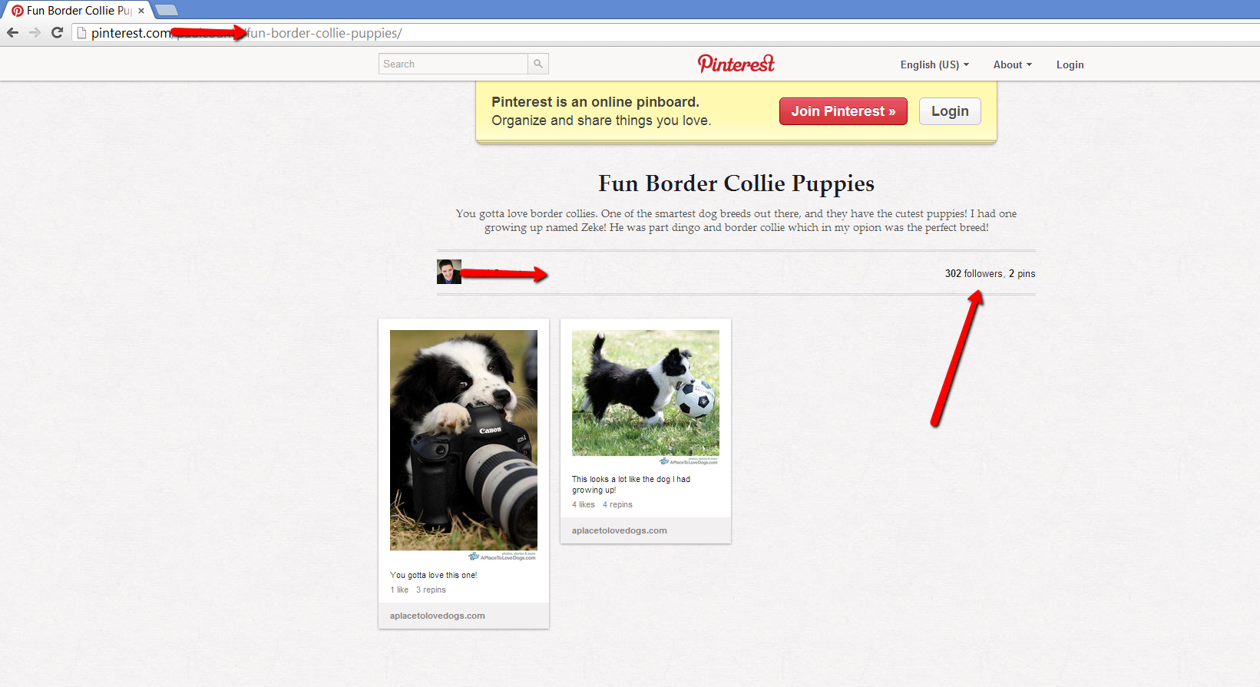
Traffic Method #3: Pinterest

Slide 21
Traffic Method #4: Twitter
Twitter is one of the most popular social media sites online.
It is a microblogging platform that allows for 140 characters.
You can get traffic by adding a Twitter button to your website.
  AddThis.com Social Sharing Tools
  Wordpress Plugin Like Digg Digg
Setup your own profile on Twitter for you or your company.
Follow like minded people in your niche.
Find the go to experts in your market and start following those that follow them.
Hopefully they will follow you back.
Link to your blog posts on Twitter.
Give new information and share industry specific content.
Interact with people that follow you.

Slide 22
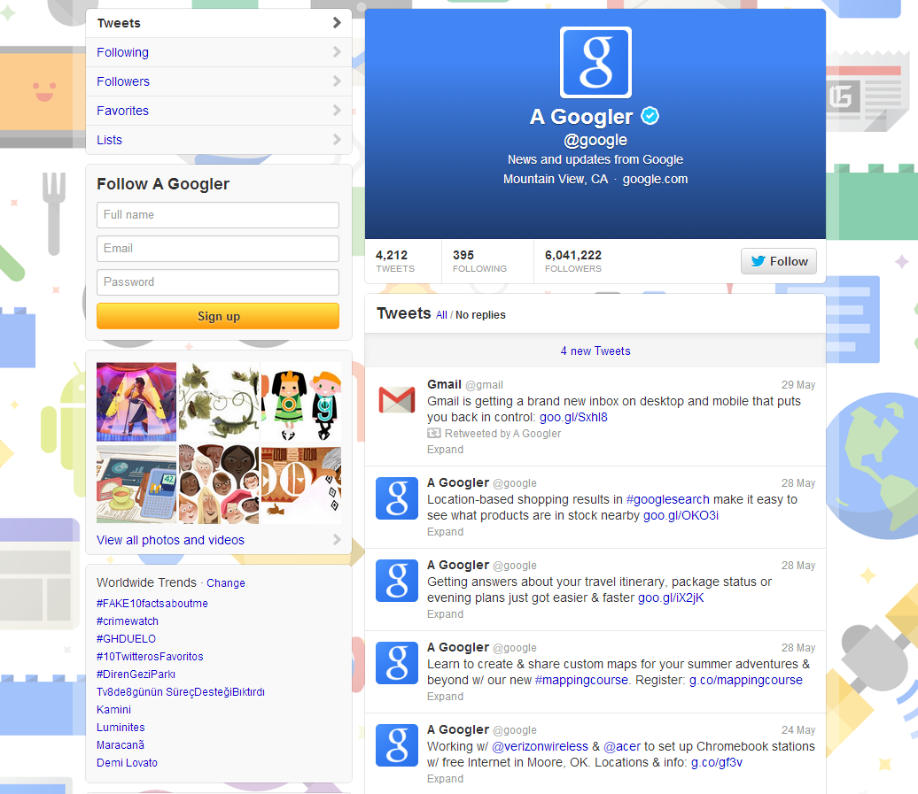
Traffic Method #4: Twitter

Slide 23
Traffic Method #5: PPC Ads
PPC Ads or Pay Per Click Ads can be a reliable traffic source.
Google Adwords – http://adwords.google.com
Bing Ads & Yahoo Ads – http://bingads.microsoft.com
You pay for each click to your website.
Can be the fastest way to get any kind of targeted web traffic that you control.
You bid what you are willing to pay on certain keywords.
Important to have a budget and plan in place.
  What are your business goals? (Leads, Sales, Affiliate Sales)
  What are your expected conversion rates?
  What is the average value of each sale or lead?

Slide 24
Traffic Method #5: PPC Ads
Look at other ads as examples when creating your ads.
Geotarget your ads to only places that are relevant.
Consider using ‘Ad Extensions’ like Site Links
Know your market and schedule ads when they are going to convert.
You don’t have to be the top. Bid for best return on investment.
Use the Google Adwords Keyword Tool for keywords.
Consider targeting keywords by exact and phrase match.
  “phrase match”
  [exact match]

Slide 25
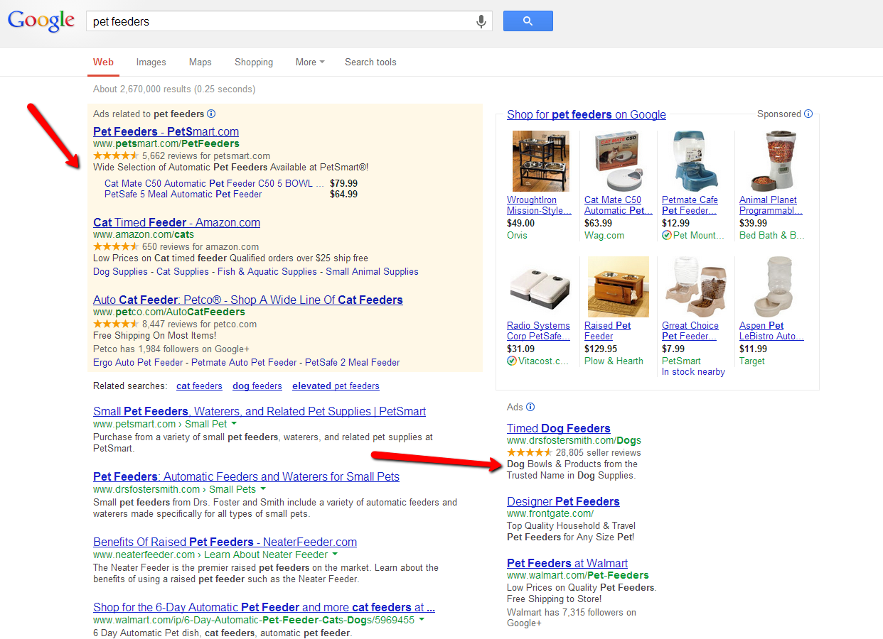
Traffic Method #5: PPC Ads

Slide 26
Traffic Method #6: Paid Banner Ads
Place your banner ads on targeted websites.
Have a banner ad created on Fiverr.com
  Search for “design banner ad”
  Use other freelancing sites like www.freelancer.com
Find sites in your niche to place your banner ad.
  Google search: Your niche “advertise here”
  Example: weight loss “advertise here”
  Google search: “your banner ad here”
  Look for banners on websites and blogs that you frequent.
  A lot of blogs offer banner ad space.
  Google Search: "powered by crankyads" weight loss (niche keyword here)
Make sure you use a tracking link so you know your performance.
Understand where the banner ad will be placed.
Know what the cost per impression or click is for the banner.

Slide 27
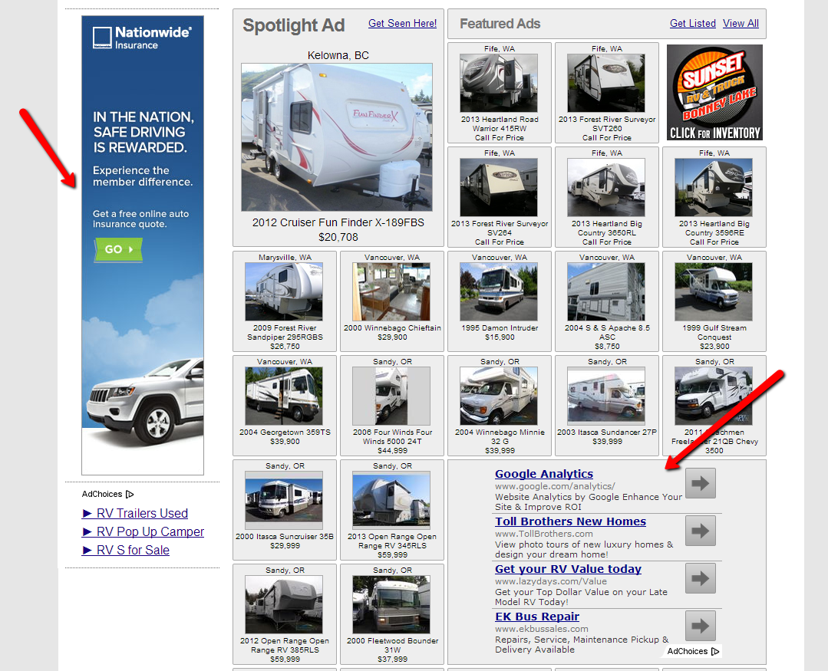
Traffic Method #6: Paid Banner Ads

Slide 28
Traffic Method #7: Amazon.com
There are several different ways to get traffic from Amazon.com.
Fulfillment by Amazon (Sell CDs or DVDs Information Products)
Sell your site’s products on Amazon.com.
Amazon Advantage self service consignment for media products.
Amazon Product Ads for your ecommerce site.
Amazon Display Ads – Like Banner Ads on Amazon.
Publishing a book on Amazon Kindle (Include your website link.)
Publishing a physical book through CreateSpace.

Slide 29
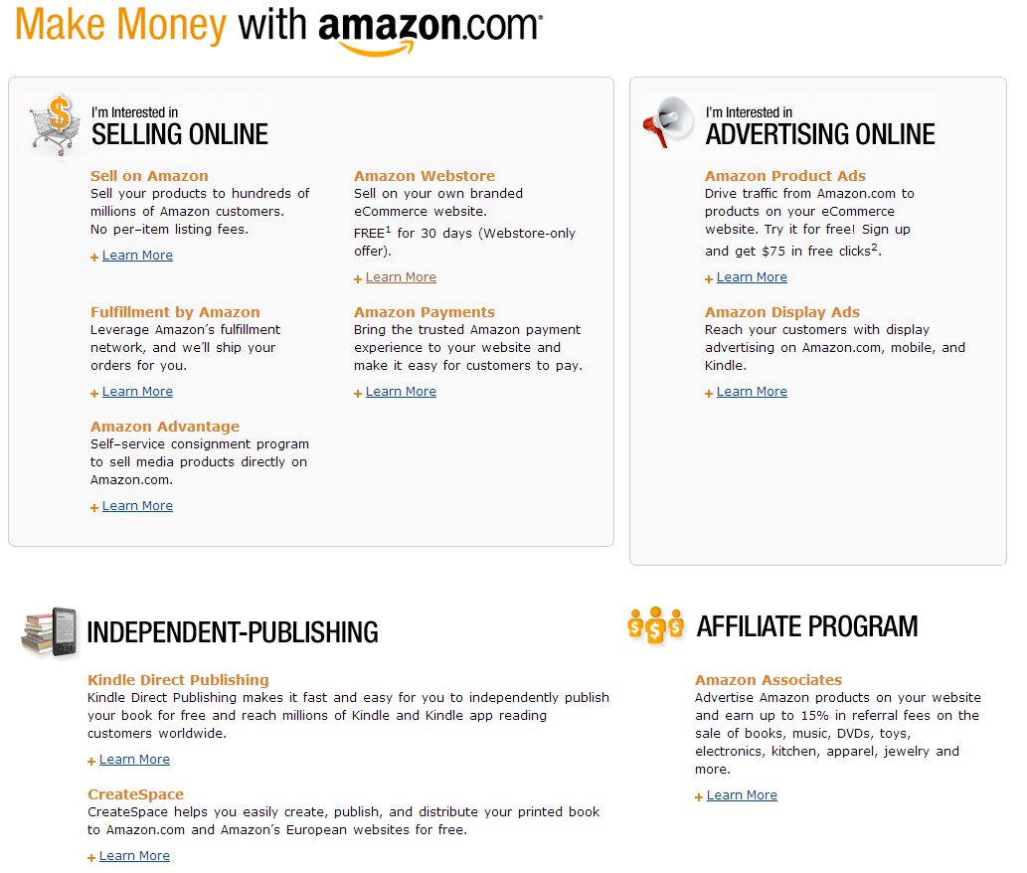
Traffic Method #7: Amazon.com

Slide 30
Traffic Method #8: Blogging
Blogging is one of the best ways to get consistent web traffic.
Wordpress is the best blogging platform out there.
Use social media plugins like Digg Digg or AddThis.
Use the Yoast SEO or All-In-One SEO Pack Plugin
Create a consistent content creation schedule.
Quality posts are better, than a large quantity of posts.
Create lists, content curation, embed videos and images, create content your niche wants.
Create a community and open up commenting.
Use a plugin like Spam Free Wordpress or Akismet for spam.
Share all your new posts on the social media channels with your followers.

Slide 31
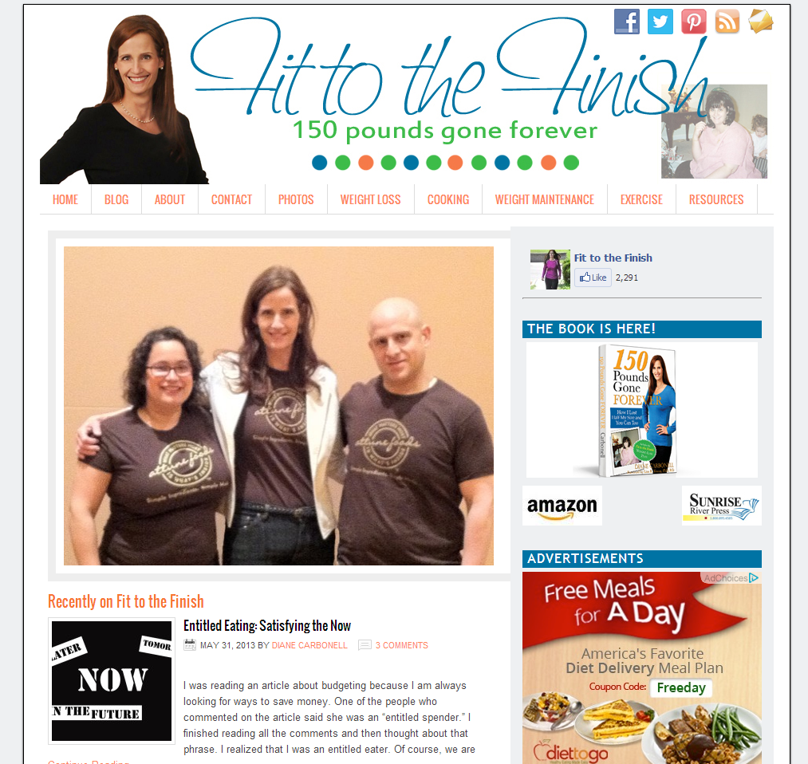
Traffic Method #8: Blogging

Slide 32
Traffic Method #9: RSS Submissions
This applies if you have a blog already.
RSS stands for Real Simple Syndication.
Fast way to distribute updates to your website.
Provides a great way to get quality backlinks.
Submit to RSS feed directories and RSS search engines.
They are sometimes referred to as Blog Directories.
To find them run a Google search for ‘rss blog directories’
TopRankBlog.com has a good list of sites to submit to.

Slide 33
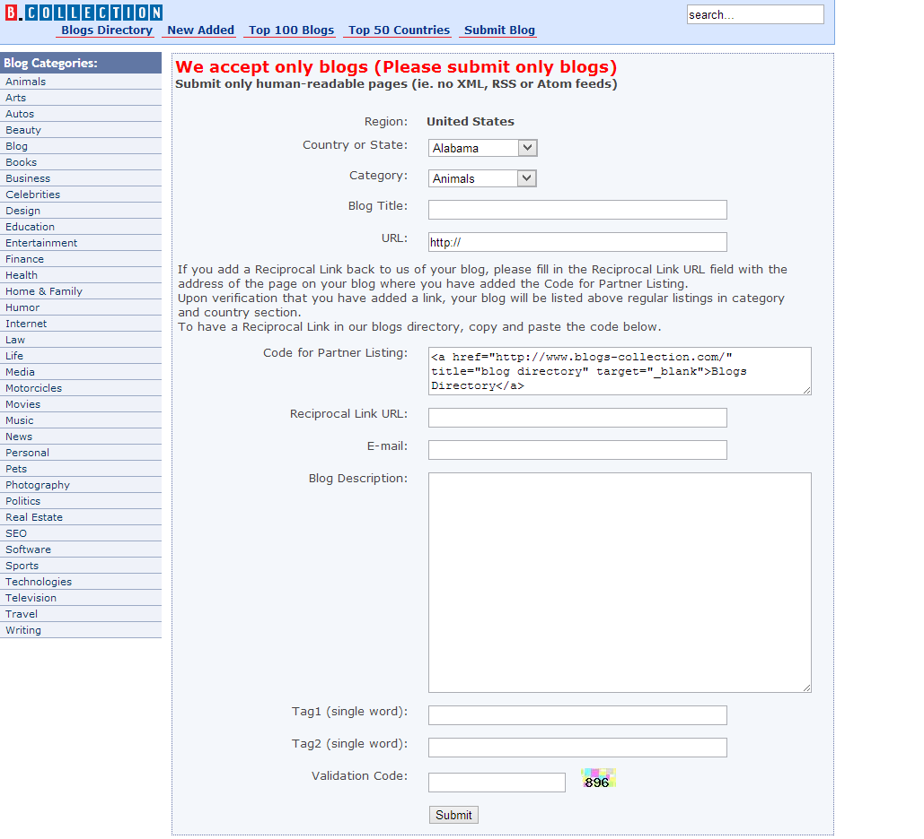
Traffic Method #9: RSS Submissions

Slide 34
Traffic Method #10: Forum Marketing
Getting traffic from forums means getting involved.
Find active forums in your niche to be a part of.
  Google Search: weight loss forum or “your niche” forum
  Google Search: fitness online forum or “your niche” online forum
They should be the highest traffic forums in your niche.
Make sure they allow you to setup your link on a profile.
A big plus is them giving you a signature line to place a link.
Get involved asking questions and responding.
Actually deliver real value to the discussions.
Get more views with quality content and occasionally controversial.
Don’t spend all your time in the forums. Use time wisely.
Maybe set a goal of 4 or 5 posts per weekday.
That is close to 100 post per month and 1,200 by year end!

Slide 35
Traffic Method #10: Forum Marketing
Certain forums offer a “buy, sell, trade” section.
  Google Search: “buy, sell, trade” forums & your niche
Typically you find this with webmaster forums.
Internet Marketing forums often have a special offer section.
  www.warriorforum.com
Post offers that the community wants in these areas.
Post in the classified section.
This can be an excellent source of targeted traffic.

Slide 36
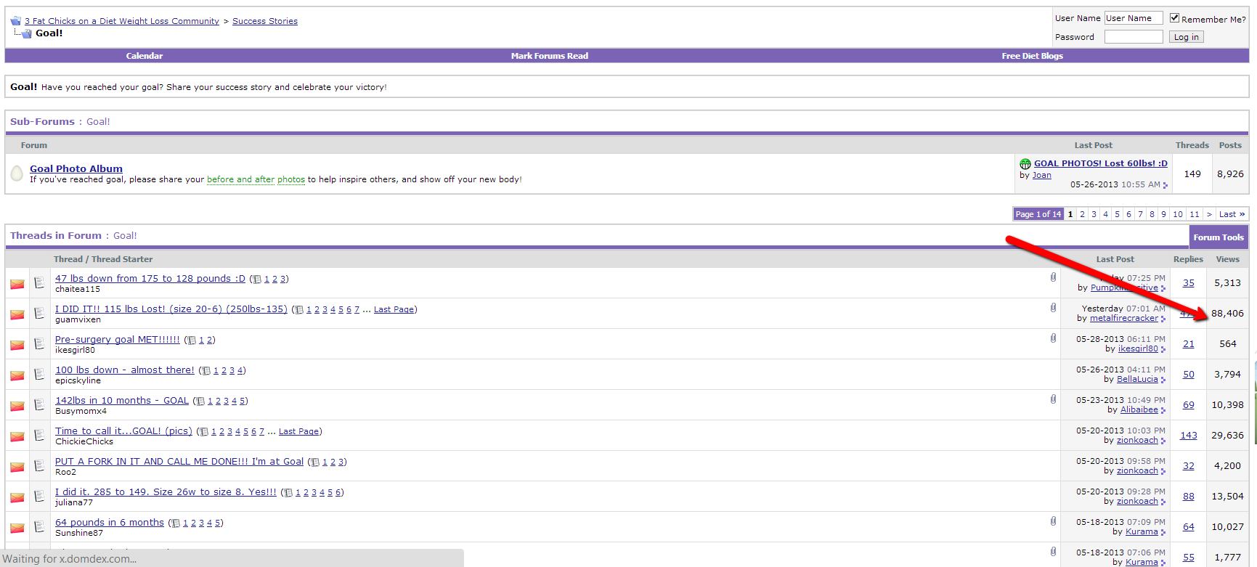
Traffic Method #10: Forum Marketing

Slide 37
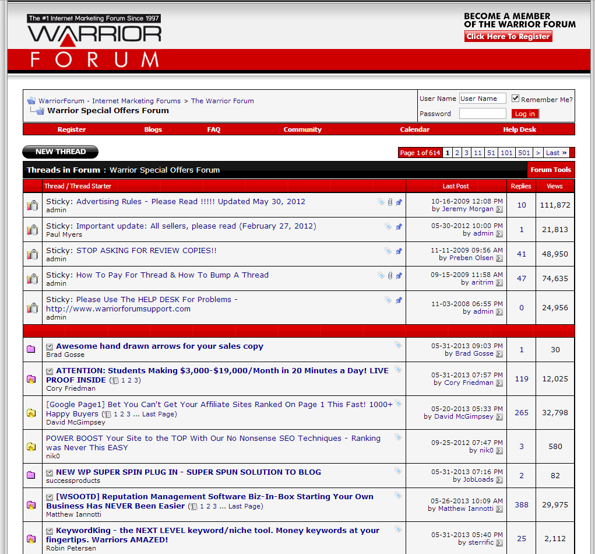
Traffic Method #10: Forum Marketing

