Slide 1
25 Website Traffic Methods Exposed
Part 2
Proven Methods to Get Targeted Traffic To Your Website

Slide 2
Proven Website Traffic Methods
SEO (Search Engine Optimization)
Facebook
Pinterest
Twitter
PPC Ads
Paid Banner Ads
Amazon
Blogging
RSS Submissions
Forum Marketing
Q&A Sites
Press Releases
Online Classifieds
Directory Submissions
Social Bookmarking
Article Submissions
Guest Blogging
Web 2.0 Sites (Squidoo, etc.)
Old School Marketing
Solo Ads
Joint Ventures
Blog Commenting
Viral Report
Video Marketing
Document Sharing Sites

Slide 3
Traffic Method #11: Q&A Sites
Q&A sites are websites where people ask questions and give answers.
It is a social website with fresh updated content.
Some authority websites are Q&A sites.
http://answers.yahoo.com
www.answerbag.com
Create your account and include your website link in the profile.
Search for questions related to your niche market.
Give good, quality answers.
On a few answers link to a blog post on your site.
Maybe link to an article on an article directory.
Every day spend like 10 to 15 minutes on these sites.

Slide 4
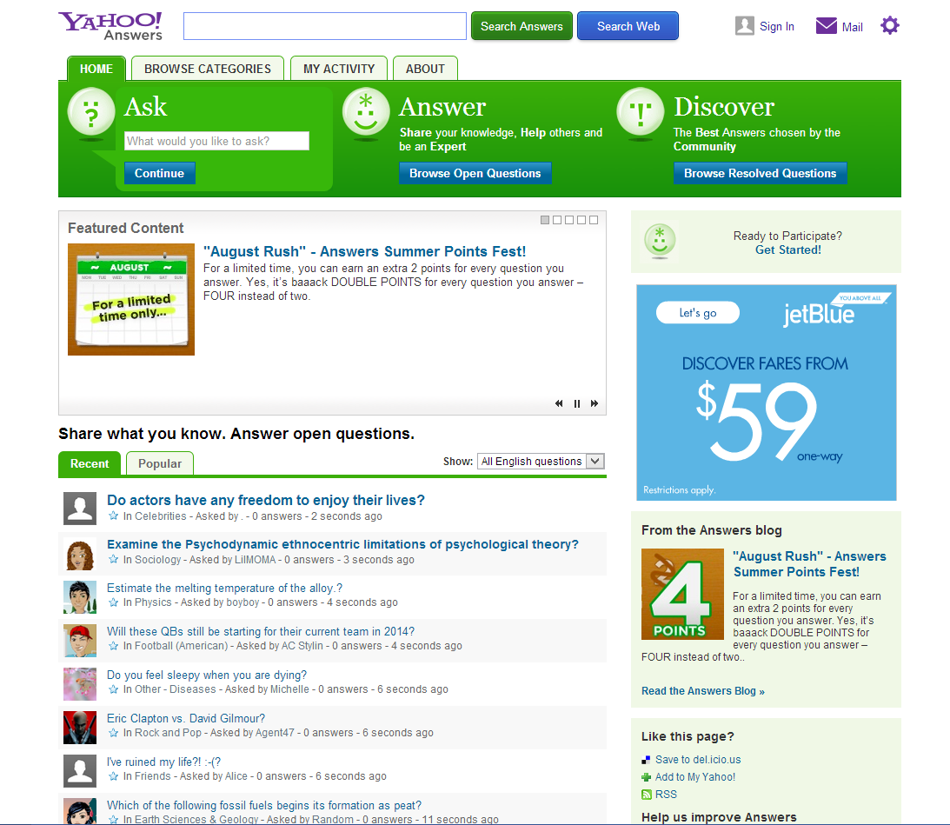
Traffic Method #11: Q&A Sites

Slide 5
Traffic Method #12: Press Releases
Press releases are a great way to get exposure and traffic.
Can send long term traffic and build credibility.
Good press releases tell the story.
Who, What, When, Where, Why, & How (Sometimes)
Tell people about:
New blog posts, controversial articles, product launches, new sites, etc.
Write press releases addressing current events in the news.
For examples of press releases:
www.prweb.com/recentnews
www.1888pressrelease.com
Places to submit your press releases.
www.prunderground.com (Paid)
Search: “submit press release free”
Search: “submit press release online”
Search: “distribute press release”

Slide 6
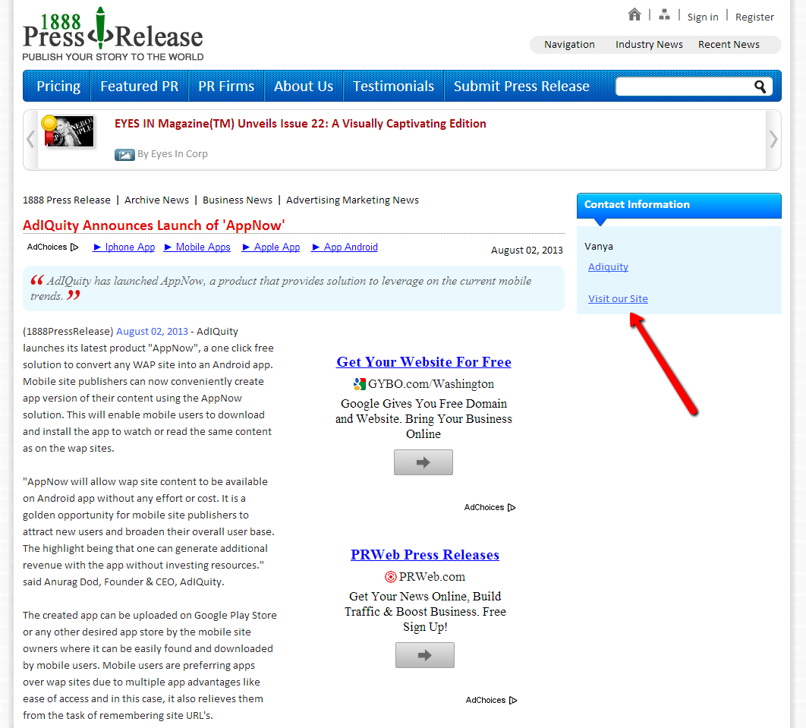
Traffic Method #12: Press Releases

Slide 7
Traffic Method #13: Online Classifieds
Online classifieds can be a great way to get traffic.
Post small ads in relevant areas with links to your offer.
Be careful about posting too many offers at once.
Post in the major city categories to maximize exposure.
Ads can be short and sweet like your squeeze page headline.
For examples of online classified sites:
www.craigslist.org
www.backpage.com
www.adoos.com
Search: “online classified sites”
Search: “free classified sites”
Search: “submit ad free”

Slide 8
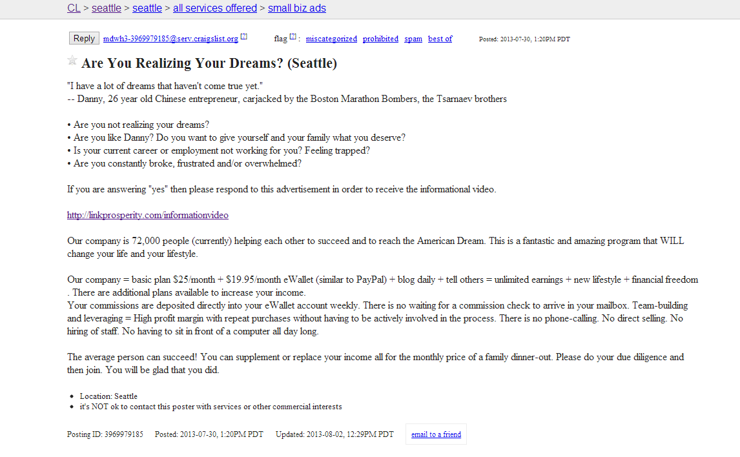
Traffic Method #13: Online Classifieds

Slide 9
Traffic Method #14: Web Directories
Targeted niche web directories can send you traffic.
List your main websites in the web directories.
Web Directories to Submit To
www.dmoz.org
www.botw.org (Consider paying for this one.)
www.joeant.com
Finding niche directories and categories to submit to.
Search: weight loss directory “submit site”
Search: business directory “submit site”
Search: fitness “submit site free”
Be careful about doing too many link backs.
Check when the page you are submitting to was last cached by Google.
Google Search cache:http://www.cotid.org/Health/Self_Improvement/Weight_Loss/
If it has been more than 45 to 60 days since it was last indexed move onto a different directory.
Use your website name in the title.
Write a good description of your website to increase the click through to your site.

Slide 10
Traffic Method #15: Old School
Works really well if you have a broad niche such as:
Weight loss, fitness, work from home, money saving, resumes, etc.
Business Cards (VistaPrint)
Include just a website on there with a short headline or incentive.
Place on community bulletin boards in your community.
Banners
Place small banners on a stake and put into ground.
Only place on public property where you are allowed to post it.
Create Fliers with Tear Papers
Create a flier describing your offer.
Have small tear sheets below with your website link.
Only place on bulleting boards you are allowed to post on.
Postcards
Get a targeted mailing list from a reputable provider like InfoUSA.
Create a basic postcard (Use CactusMailing.com)
Send postcards with website and targeted message.

Slide 11
Traffic #16: Social Bookmarking (Watch Video for Training)

Slide 12
Traffic #17: Article Submissions (Watch Video for Training)

Slide 13
Traffic #18: Guest Blogging (Watch Video for Training)

Slide 14
Traffic #19: Web 2.0 Sites (Watch Video for Training)

Slide 15
Traffic #20: Solo Ads (Watch Video for Training)

Slide 16
Traffic #21: Joint Ventures (Watch Video for Training)

Slide 17
Traffic #22: Blog Commenting (Watch Video for Training)

Slide 18
Traffic #23: Viral Reports (Watch Video for Training)

Slide 19
Traffic #24: Video Marketing (Watch Video for Training)

Slide 20
Traffic #25: Document Sharing Sites (Watch Video for Training)

